Slide 1


NeuroBME
Principles of
Programming
Soroush Mirmobini
2025

Slide 2
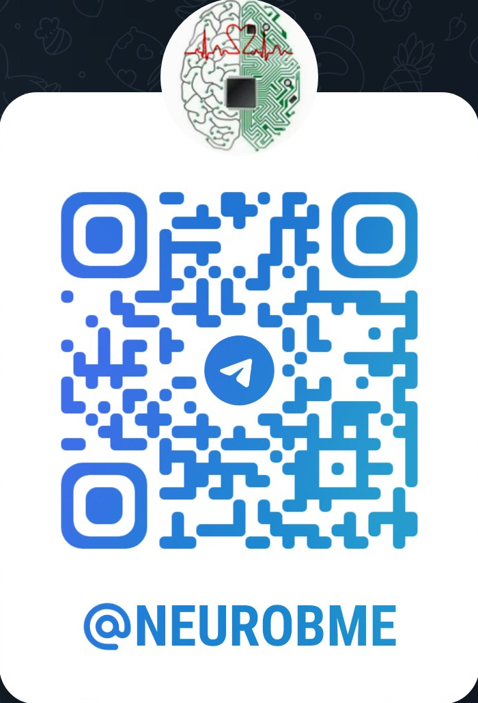


Channel
Contact
https://t.me/soroushmirmobini
soroushmirmobini@gmail.com
https://t.me/NeuroBME

Slide 3

Telegram Group

Slide 4


Reference
https://www.elsevier.com/books-and-journals/book-companion/9780323857734

Slide 5
Table of Contents
Start
Introduction to Computer Programming
Introduction to MATLAB
Arrays & Linear Algebra
Functions
Text and Files
Visualization
Control Structures
Solving Equations
Statistics
Supplementary Topics
End

